Slide 1
ECE 313: PROBABILITY WITH ENGINEERING APPLICATIONS
Fall 2023
Prof. Eric Chitambar
Lecture 19

Slide 2



The Uniform and Exponential Distribution

Slide 3

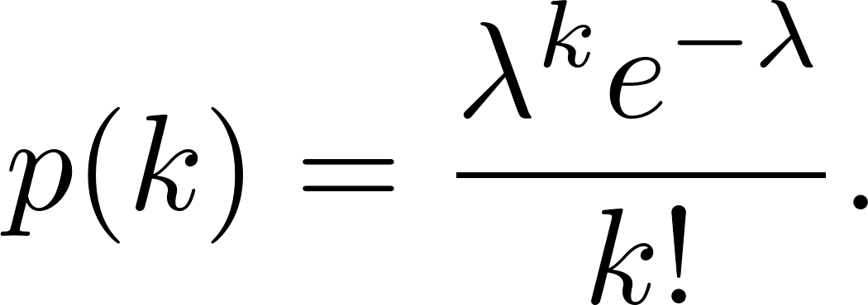

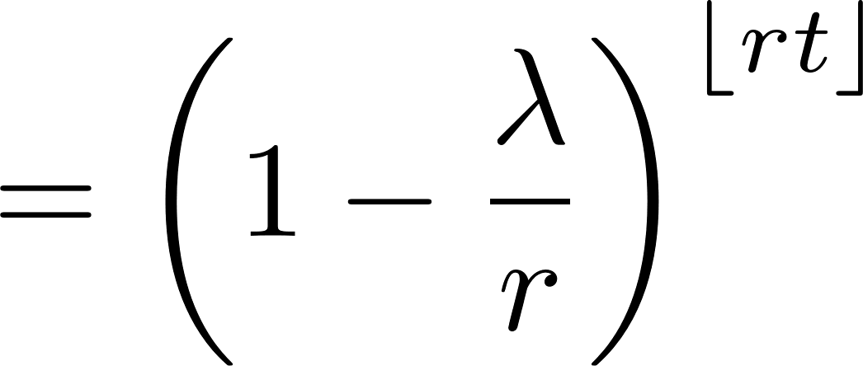



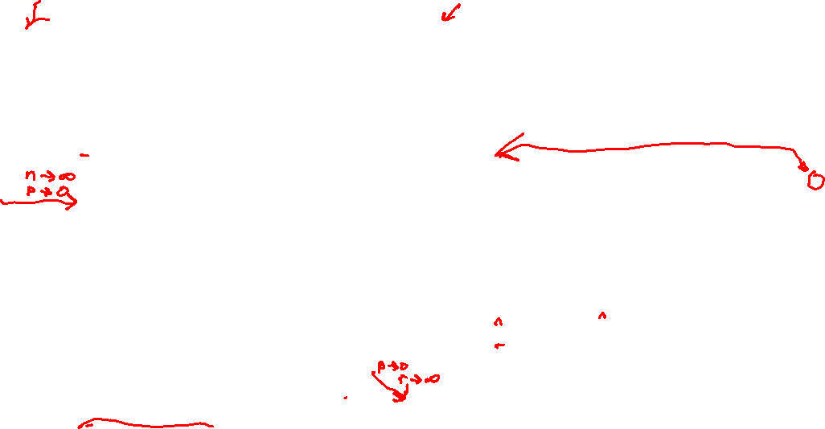
The Poisson and Exponential Distributions

Slide 4
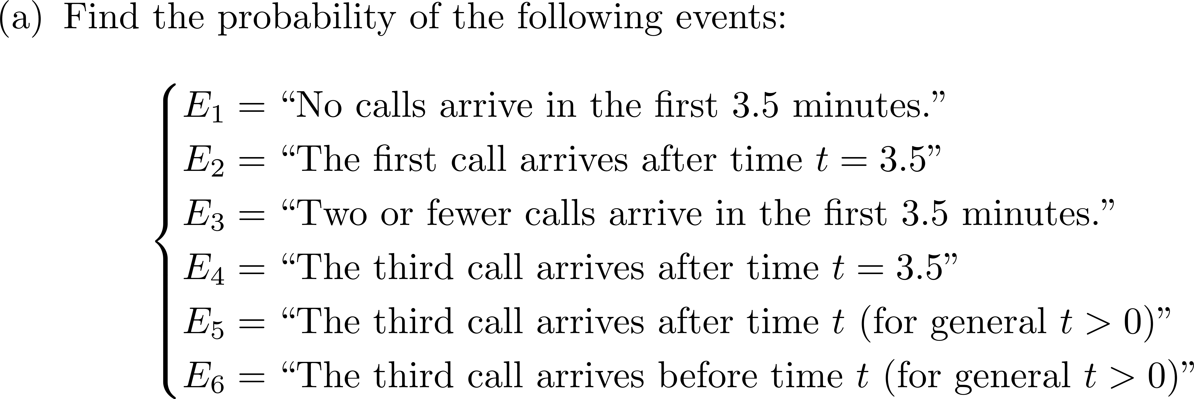
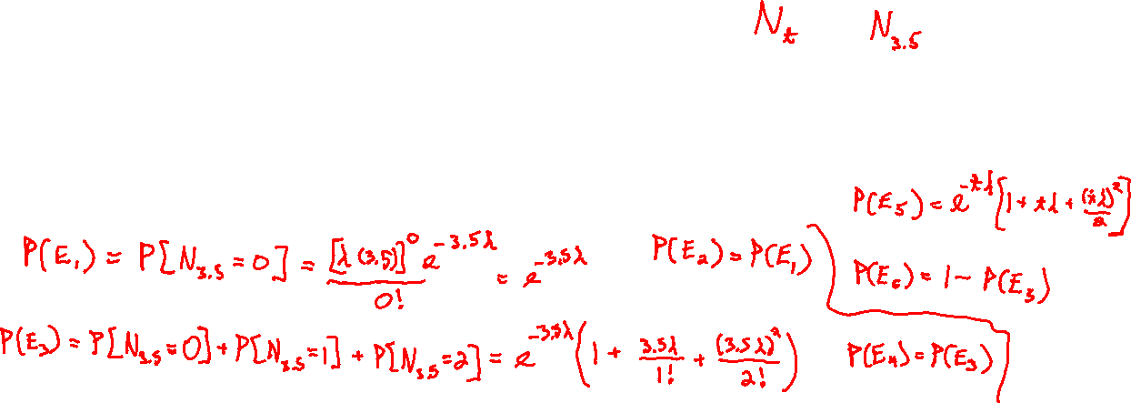

A Poisson Process

Slide 5
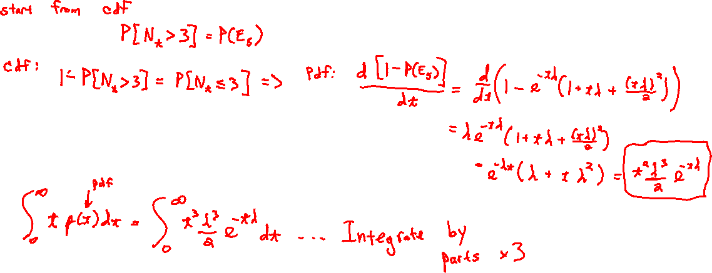
A Poisson Process

Slide 6



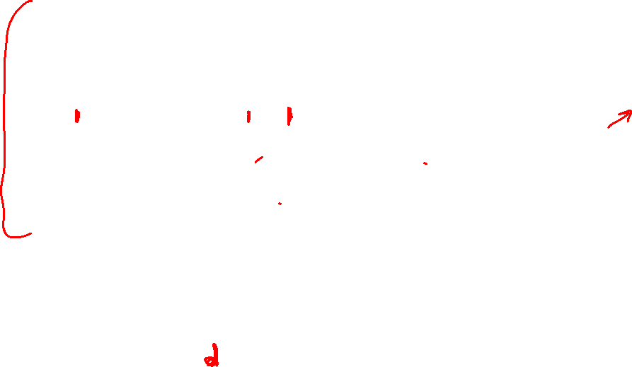
A Poisson Process

Slide 7
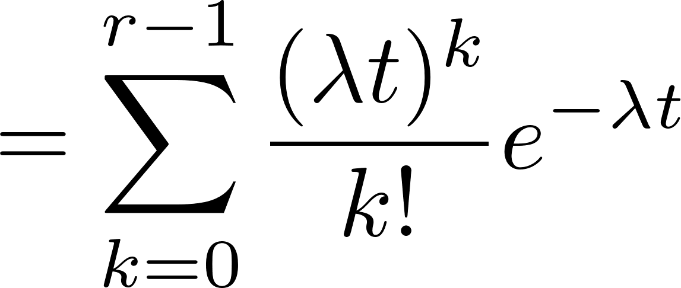

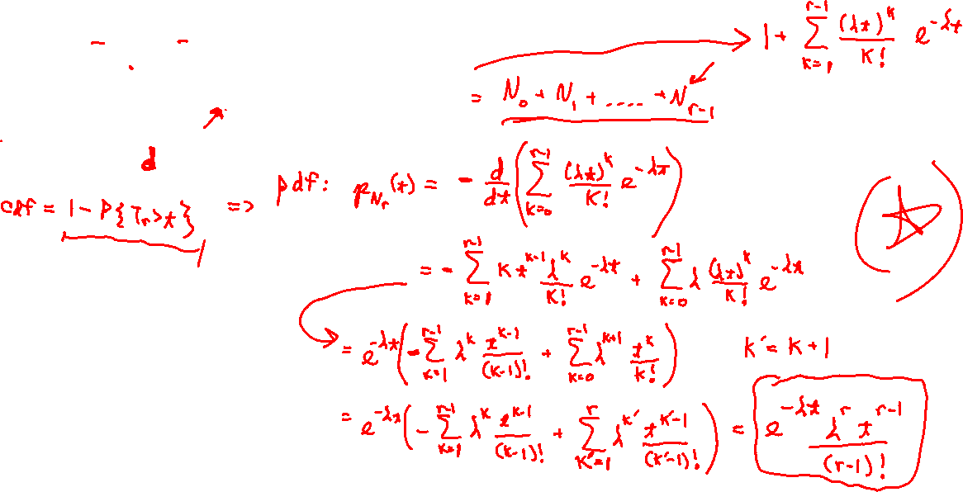
The Erlang Distribution

Slide 8

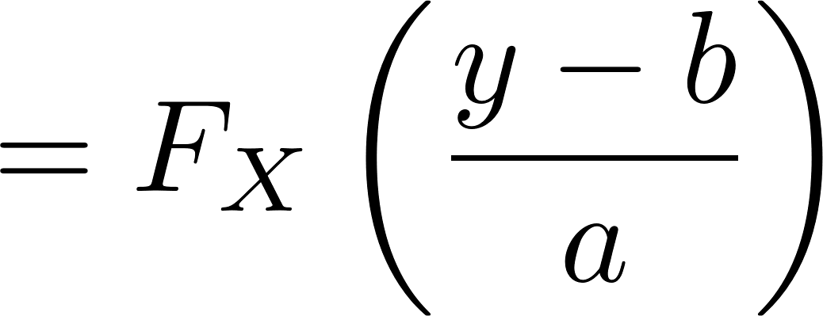





Linear Scaling of pdfs

Slide 9

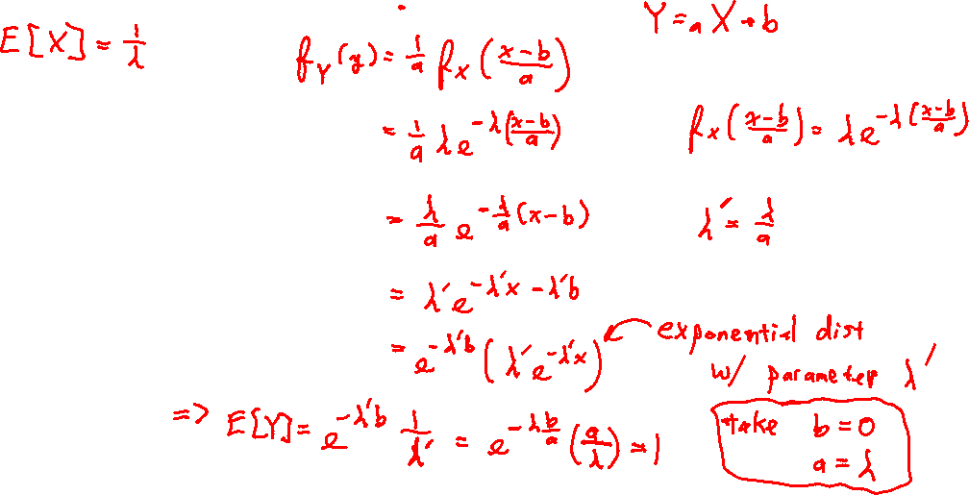




Linear Scaling of pdfs

